Slide 1
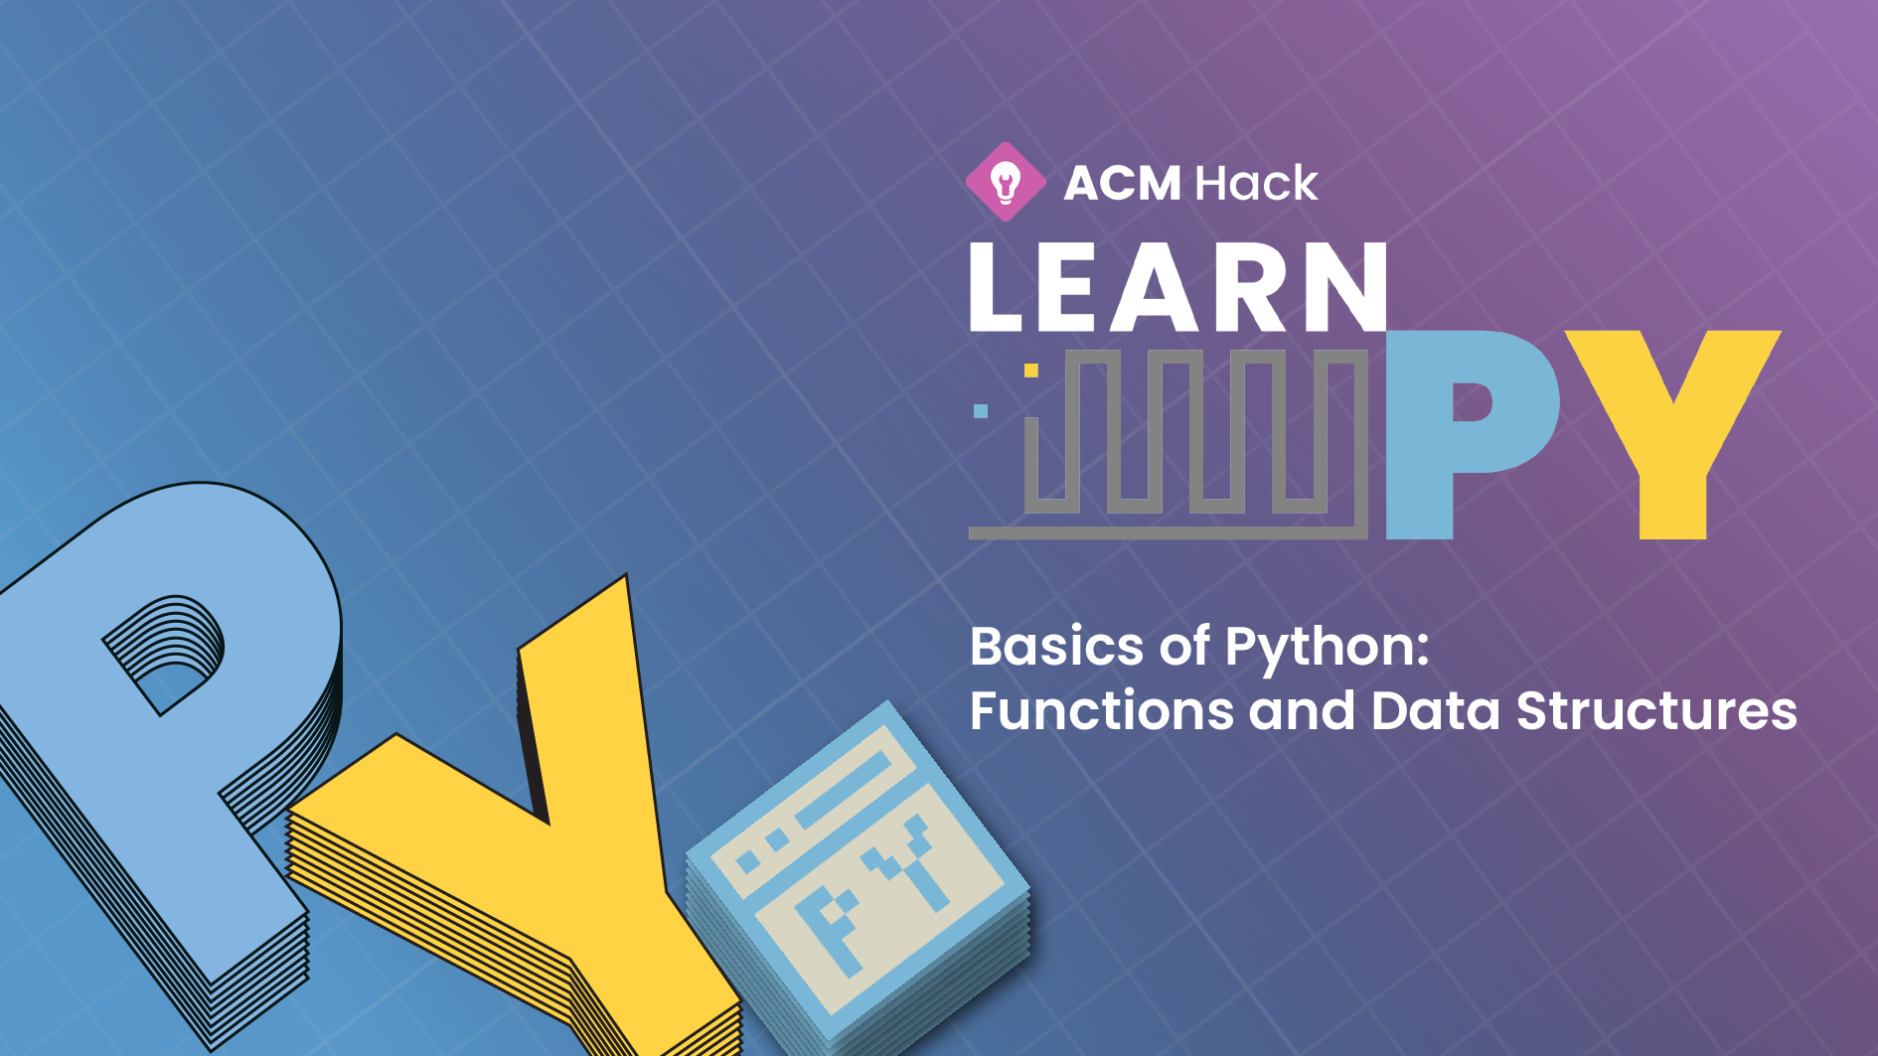

Slide 2
Link to slides:
tinyurl.com/
Link to README:
tinyurl.com/
Attendance Code:
#

Slide 3
Overview of Learn.py
Session 1 - 3: Basics of Python
Data Types, I/O, and Control Flow
Functions and Data Structures
Classes/Objects, Modules, and File Handling
Session 4-8: Applications of Python
Pygame
Data Mining and Modeling
Web Scraping
Web Dev Part 1
Web Dev Part 2

Slide 4
Overview of Learn.py
Session 1 - 3: Basics of Python
Data Types, I/O, and Control Flow
Functions and Data Structures
Classes/Objects, Modules, and File Handling
Session 4-8: Applications of Python
Pygame
Data Mining and Modeling
Web Scraping
Web Dev Part 1
Web Dev Part 2

Slide 5



Raffle Today!!!
Amazon Gift Card
To Be Revealed
To Be Revealed
To Be Revealed

Slide 6
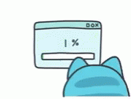

Download Sublime (Text Editor)
https://www.sublimetext.com/

Slide 7
Download Python
Download the Python 3 installer (https://www.python.org/downloads/)
Click "Download Python 3.x.x" (As of now, it’s 3.7.3)
Run the installer (find in File Explorer or Finder and double-click)
For Windows: Make sure to check "Add Python 3.x to PATH"
For Mac: Hit continue and agree for everything to finish installation
To Run Python
Open Terminal(Mac)/Powershell or Command Prompt(Windows)
Type: On Mac: python3 On Windows: python

Slide 8
Functions

Slide 9
Functions
Functions are code that hold other code for easy access, organization, and convenience
def function_name(arguments):
[code contained]
[must be indented]
[to be included in the function]
(optional return value)
Arguments are variables that we pass into our function to give the code inside access to their values
return value is what is returned by the function when it is called

Slide 10
Scope
All variables have a scope
Scope determines the visibility of the variable
Defined using indentation.
def function:
x = has_scope_of_function
y = has_global_scope

Slide 11
Functions
We can call one function in another!
def function1():
print(4)
def function2():
function1()

Slide 12
Functions: Default parameters
We can supply default parameters to our functions.
These default values are used in cases where parameters are not specified.
def function(arg = 5):
print(arg)
function() #prints 5
function(4) #prints 4

Slide 13
Lambdas
Lambdas are simple, one-line functions.
def func = lambda x, y: x+y
Use the keyword lambda
List the arguments
After the colon, implement a one line expression
The function will return the evaluation of the one line expression.
Condense functionality in ONE line!

Slide 14
Basic Data Structures
List
Tuple
Set
Dictionary

Slide 15
List
A list is a way to store multiple elements in the same variable.
mylist = [element1, element2, element3]
numList = [2, 5, 6, 88]
Uses square brackets to contain all the elements.
Can access elements using index:
x = numList[0]#stores 2 in x

Slide 16
List: Looping through
You can loop through a list to access every single element in the list
mylist = [element1, element2, element3]
for x in mylist:
print(x)

Slide 17
List: Methods
Methods are inbuilt functions you can call on lists.
They are ready to use, no need to worry about their implementation!
Append(element)
Remove(element)
Extend(newList)
More at:
https://www.w3schools.com/python/python_ref_list.asp

Slide 18
List: Comprehension
List comprehension is a concise way of creating new lists based on existing lists.
Allows you to modify and choose elements from the old lists for your new list.
newList = [ expression(i) for i in oldList if condition ]

Slide 19
List: Slicing
Slicing allows you to make a new list that is a subset of a pre-existing list.
oldList = [1, 2, 3, 4]
newList = oldList[startingindex:endingindex]
Slicing extracts the part of the list starting at the first index before the : and ending right before the second index after the :

Slide 20
List: Slicing
You can also define the jump you take while extracting a subset.
newList = oldList[startingindex : endingindex : length of jump]
For example: if the jump were two, it would take alternate elements.
Default arguments:
The default for starting and ending index is the beginning and the end of the list.
newList = oldList[ : ] #considers the entire list

Slide 21
Tuple
Tuples are essentially lists that cannot be changed.
Declared using round brackets:
mytuple = (element1, element2, element3)
Cannot add/remove/change any element
Can access elements:
mytuple[0] #this is element1

Slide 22
Tuple: Uses
Sensitive information
Complex functions → you don’t want any function accidentally modifying your data
Find out more at:
https://www.w3schools.com/python/python_tuples.asp

Slide 23
Set
Contains several elements like a list
Cannot access one element using the index
Defined using curly braces
myset = {element 1, element2, element3}
Do not allow duplicates: every element is unique.
Find out more at:
https://www.w3schools.com/python/python_sets.asp

Slide 24
Dictionary
A collection of Key-Value pairs.
Every value can be accessed only with its key.
Defined using curly braces and colons:
myDict = {
Key1 : value1
Key2: value2
}

Slide 25
Dictionary
Can access elements:
x = myDict[key1] #stores value1 in x
All keys must be unique
Can be used to associate two values to each other
Find out more:
https://www.w3schools.com/python/python_dictionaries.asp

Slide 26
Map
Map is a function that allows you to call other functions on every element of a list without having to call it on each element individually.
It takes two parameters: the function to be called on every element of the list and the list itself
It returns another list of the result values of each call on each element
It can be used with tuples, sets and dictionaries too!

Slide 27
Map
def myfunc(x):
return x+5
myList = [el1, el2, el3]
newList = map(myfunc, myList)
Find out more:
https://www.geeksforgeeks.org/python-map-function/

Slide 28
Fill out our survey!
https://tinyurl.com/learnpy-f1

Slide 29
Next Session
Basics of Python: Classes/Objects, Modules, and File Handling

